Slide 1
Capacity Building and Raising Awareness in Europe and in Third Countries to Cope with Xylella fastidiosa – “CURE-XF”
In collaboration with:
International Summer School
Modelling the spread of Xylella fastidiosa
for improving the surveillance programs: Pre-Session Instructions
Dr Daniel Chapman, UKRI Centre for Ecology & Hydrology, UK
CIHEAM Bari, 1st October 2018
#CureXFSS2018

Slide 2


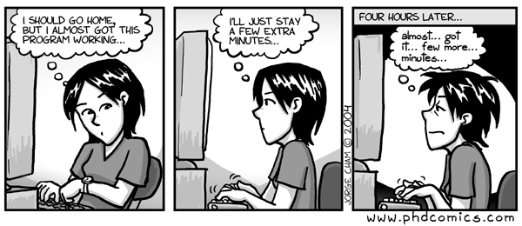
In the session we will use the computer language R to run models...
...but you will not need to know any coding in R!!!

Slide 3
Please bring your laptop to the session on 1st October. Before then, please follow these instructions to install R
Download and install R 3.5.1 from https://cran.stat.unipd.it/ or any of the ‘mirrors’ linked at https://cran.r-project.org/mirrors.html
Install all the R packages (libraries of functions) we need to run the models. To do this open R and paste this directly into the console...
install.packages(c("shiny","ggplot2","reshape","deSolve", "data.table", "shinyjs", "viridis"), dependencies=TRUE, repos='http://cran.us.r-project.org')

Slide 4
Finally, we will use some R scripts and data
Please download all the files we need from https://github.com/NERC-CEH/CURE-XF-Xylella-modelling and save them in a convenient folder on your computer (e.g. C:/Xylella_model)
If you have any issues, please email me on dcha@ceh.ac.uk

